Slide 1

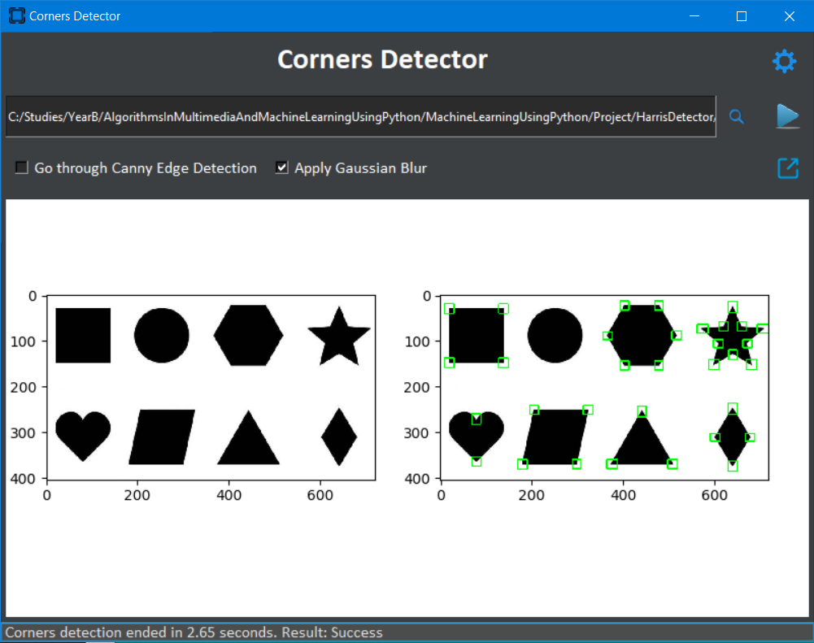

Algorithms in multimedia and machine learning in the Python environment | Location of corners and intersection of lines in an image Haim Adrian
Yakir Menahem
Introduction
Corner detection is used within computer vision systems in order to extract features from images to be recognized in some manner, e.g. object recognition, motion detection, etc.
Corner points use the distribution of few points to preserve the important features of the image, thus reduces the amount of data to be processed.
The project
The project was implemented with GUI, using Python tkinter library with interactive UI.
Images are plotted inside the main window, using embedded matplotlib frame, with an option to pop it out and have the original matplotlib frame.
The project has persistent settings, allowing user to define thresholds, select marking color and whether to use rectangles as a mark sign or dots, thus making it easier for users to compare results.
How to use
Use the settings button to view default options or modify them as you wish
Open an image using the magnifying button
After selecting an image, use the play button in order to execute the algorithm
Progress of the algorithm can be noticed at the bottom of the dialog. We display a progress bar with text telling at which phase we are and how much work (in percentage) we have done
Eventually, you can use the pop-out button in order to see the processed image alone in another frame
Conclusions
All expectations as set at the beginning have been met, with extras, for example – making it configurable to let users select thresholds, color, mark sign, and see the progress of the algorithm process by using a progress bar at the bottom of the window while the algorithm is executed.
As can be seen at the picture above, we can detect all corners in an image, as long as they are clear. We do have some errors in noisy images, where we recognize false corners, but those errors are the result of using the mathematical approach for corners detection, without a post process that analyze all corners that have been detected, and figures out which one is a real corner and which one is a false corner.
Discussions
Sources of the project, including presentation can be found on my GitHub, under ‘Project’ folder: https://github.com/haimadrian/MachineLearningUsingPython
Video is available on YouTube: https://youtu.be/zGWMElYc2OE
I use cv2.cornerSubPix as a post-process in order to find the center of each detected corner and use it as the corner, such that the results are more accurate. By using this post-process, I have encountered an issue where the center of the image is detected as a corner, even though it is empty, hence I override it with 0, and take the risk of losing a potential real corner. A more reliable solution could use the original Harris scores for detection of whether there is a corner in the middle of the picture and avoid of overriding it with zero.
Video

